Slide 1

Graduation Project Proposal Form
Project Title : ORACLE Accounts Payables MODULE
Course/Track: ORACLE DIGITAL ACCOUNTING SPECIALIST
Group Code : NEXT58 _GIZ1_ERP1_M1
Name: MOHAMED FAISAL SAAD MOHAMED

Slide 2
Oracle project
Month End Close Periods, Close Period
Exception Report
Creating Bank Reconciliation Statements
Payment Reconciliation
Miscellaneous Payment Reconciliation

Slide 3
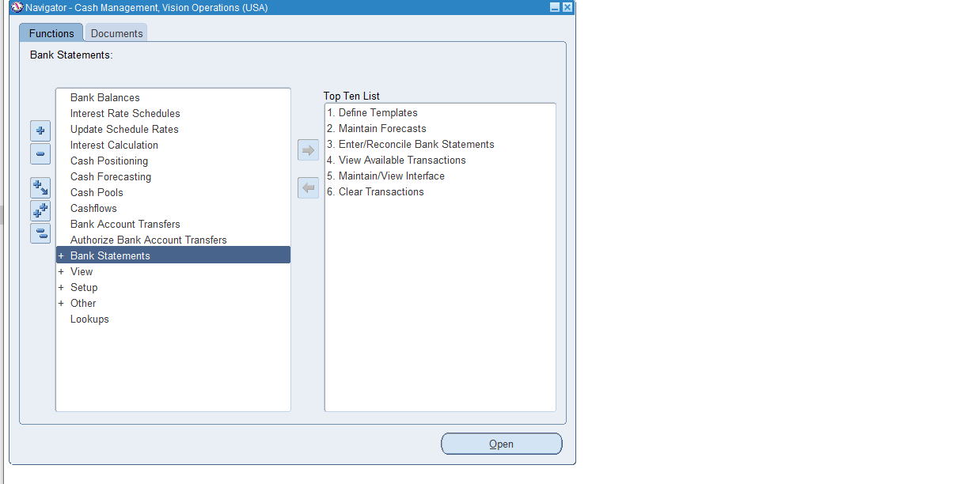
Clear payments transaction

Slide 4
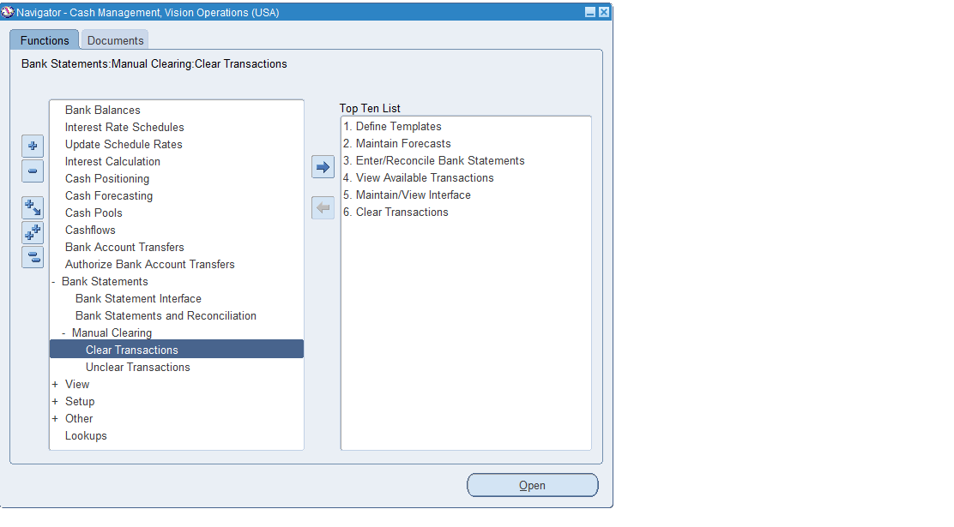
Press bank statement and manual clearing

Slide 5
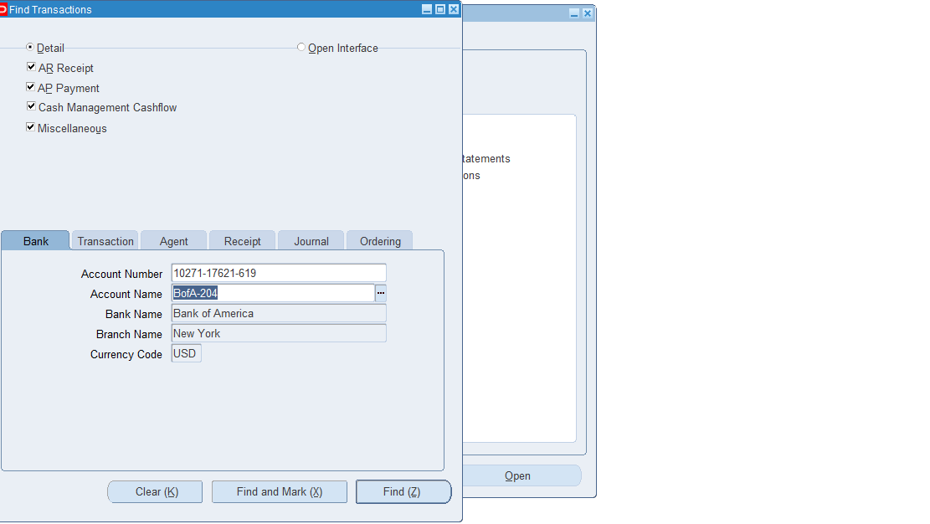
Choose bank account

Slide 6
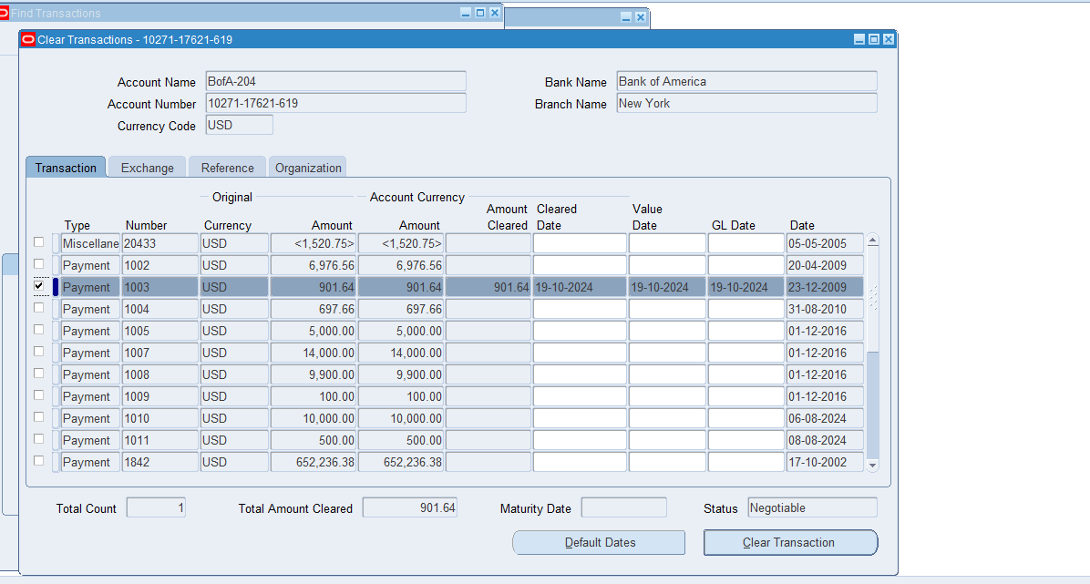
Press find and choose payment and press clear transaction

Slide 7
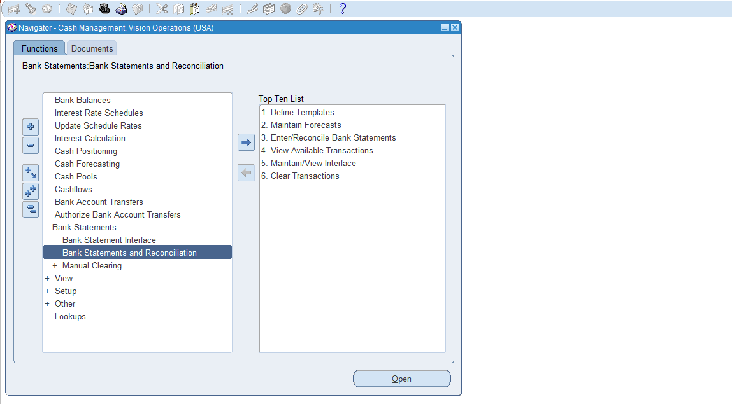
Press Bank statement and reconciliation

Slide 8
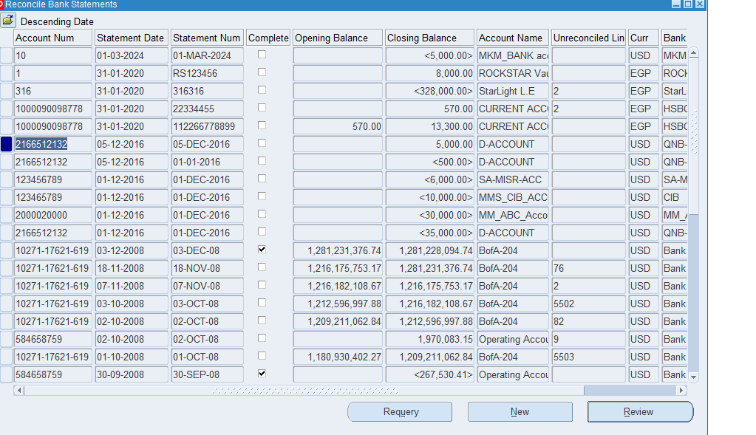
Choose Bank statement to reconcile

Slide 9
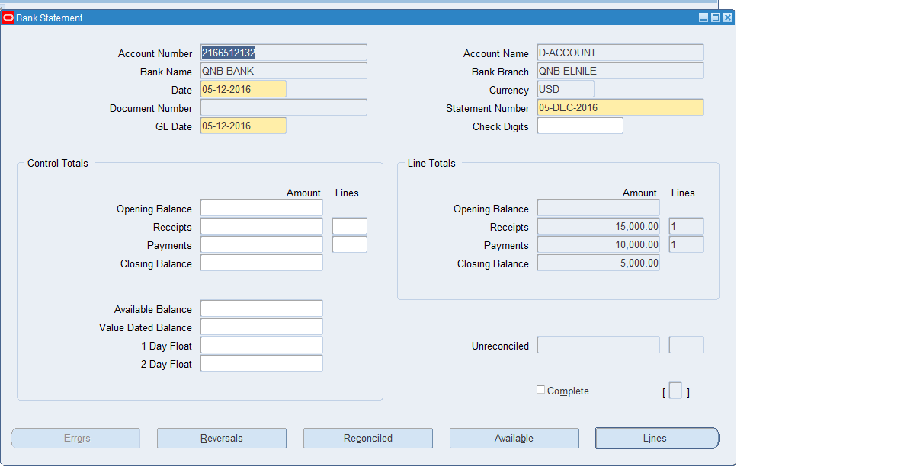
Press review and choose to reconcile all bank statement payments or click lines to choose the payments then click reconcile

Slide 10
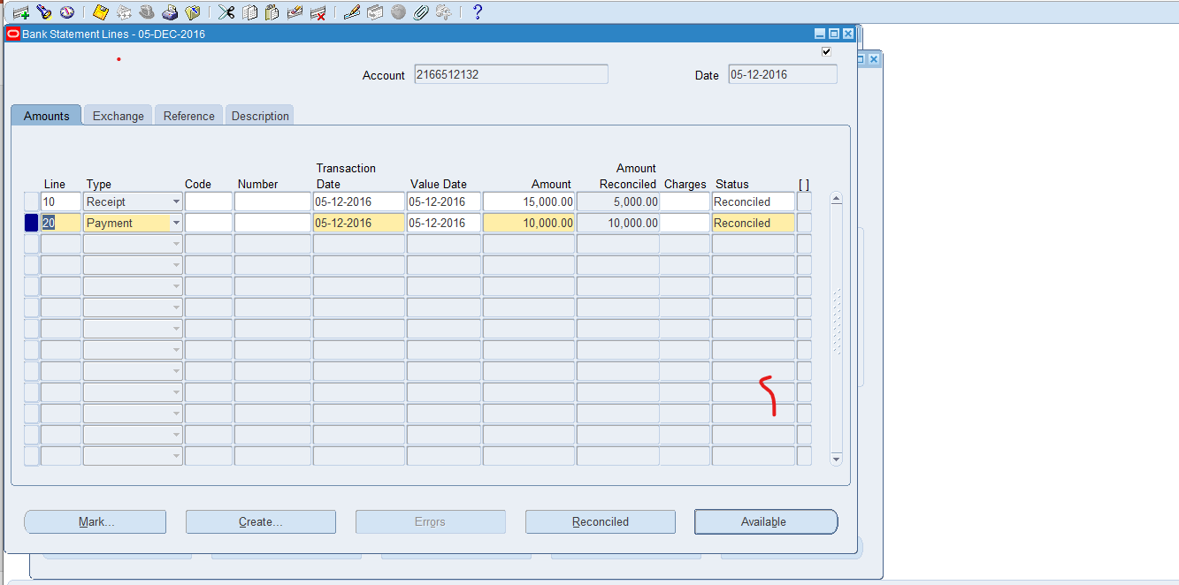
Open bank statement lines and reconcile a payment

Slide 11
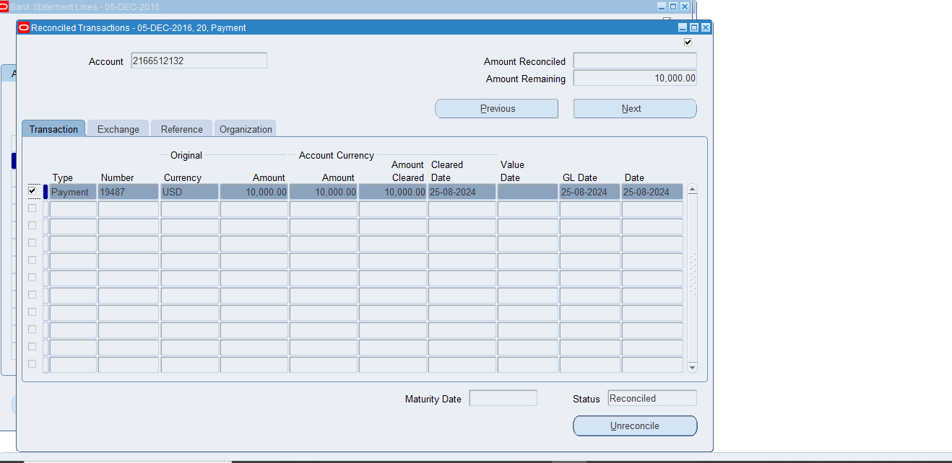
If I want to unreconcile I click unreconcile

Slide 12
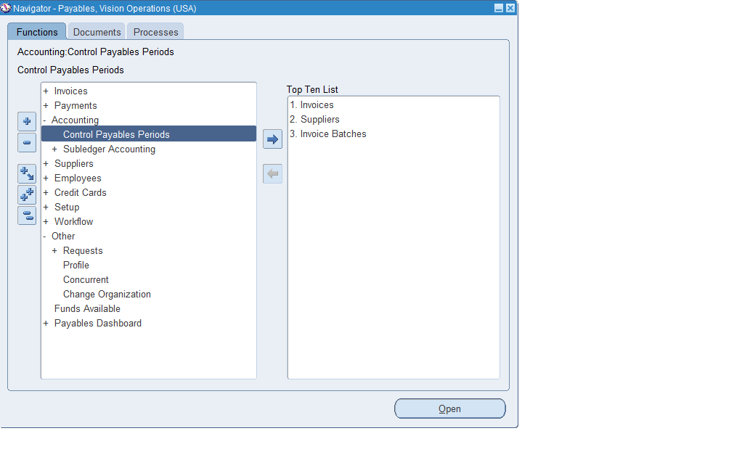
Control payables periods and Month End Close Periods

Slide 13
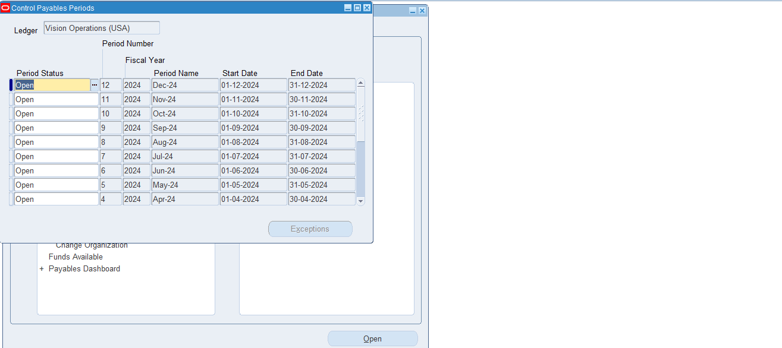
Choose a Period to close

Slide 14
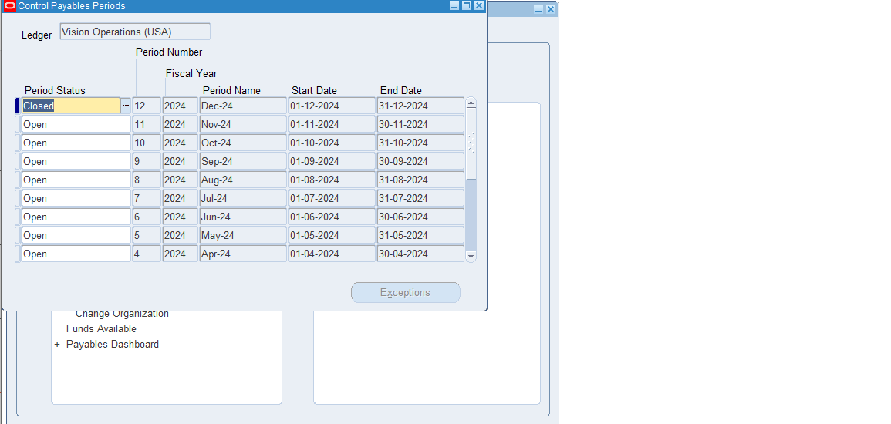
Make it closed and save changes

Slide 15
Supplier Payment History Report:
Provides details on payments made to suppliers over a specific period, allowing for tracking and analysis of payment trends.

Slide 16
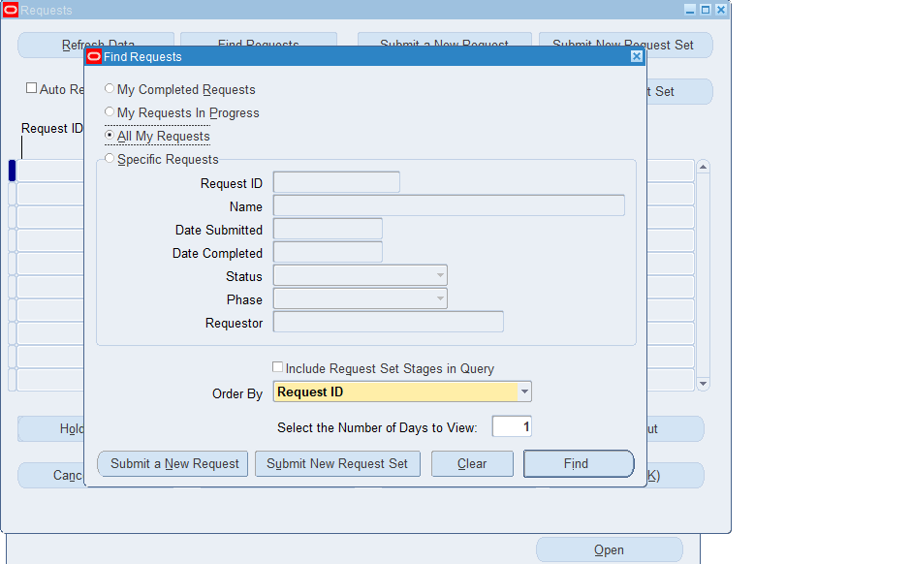
Veiw then click requests and submit a request

Slide 17
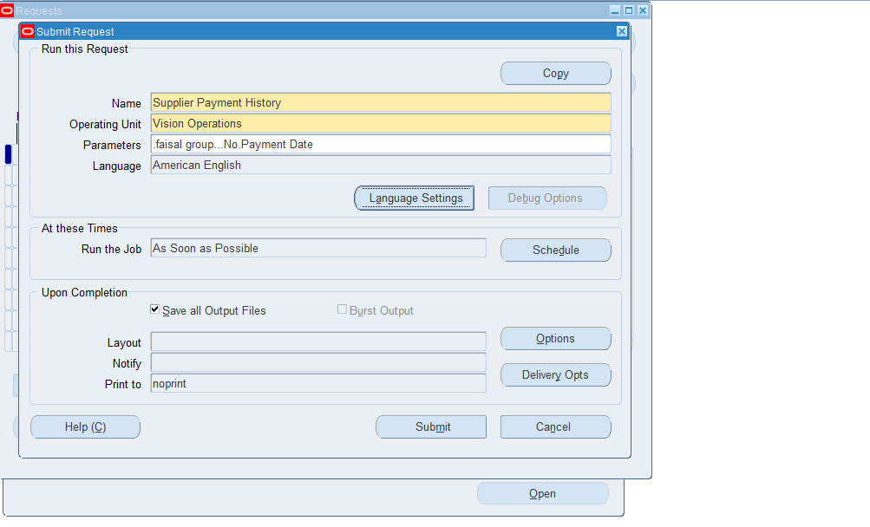
Choose a report and its parameters and submit

Slide 18
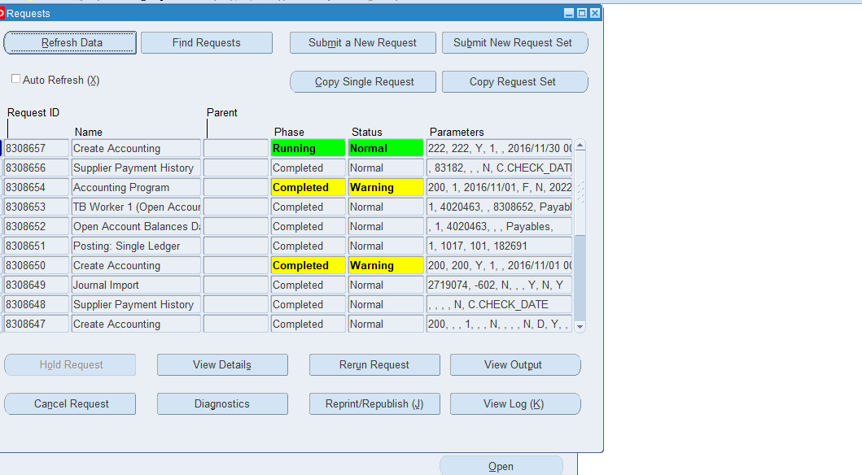
System prepare the report click view output when be completed

